Slide 1
Unsupervised learning

Slide 2
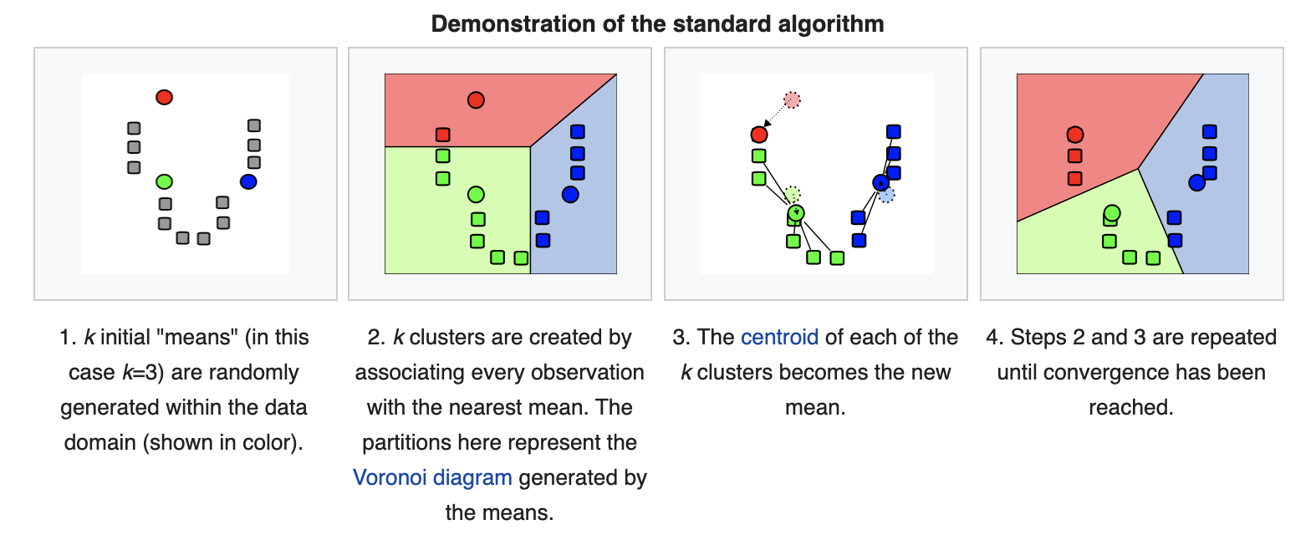
Clustering: K-means
Partition n observations into k clusters in which each observation belongs to the cluster with the nearest mean (cluster centers or cluster centroid)

Slide 3
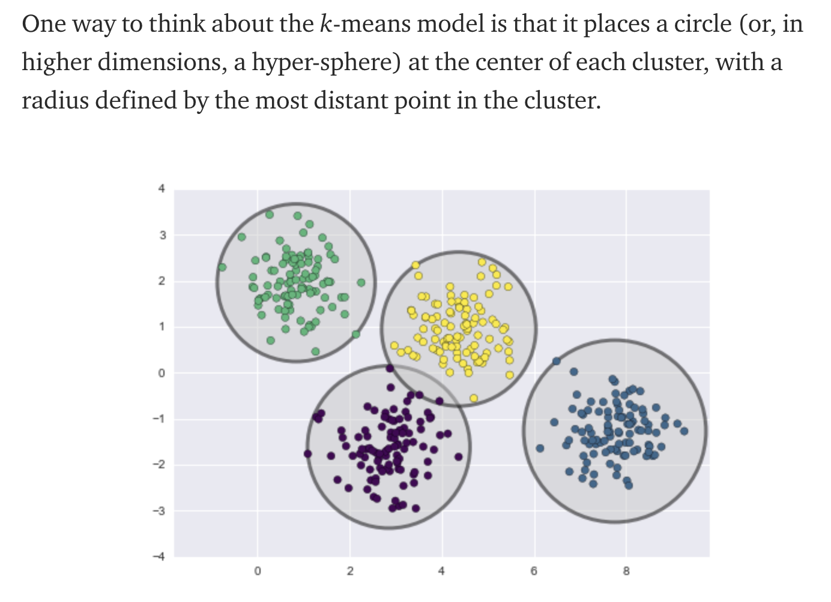
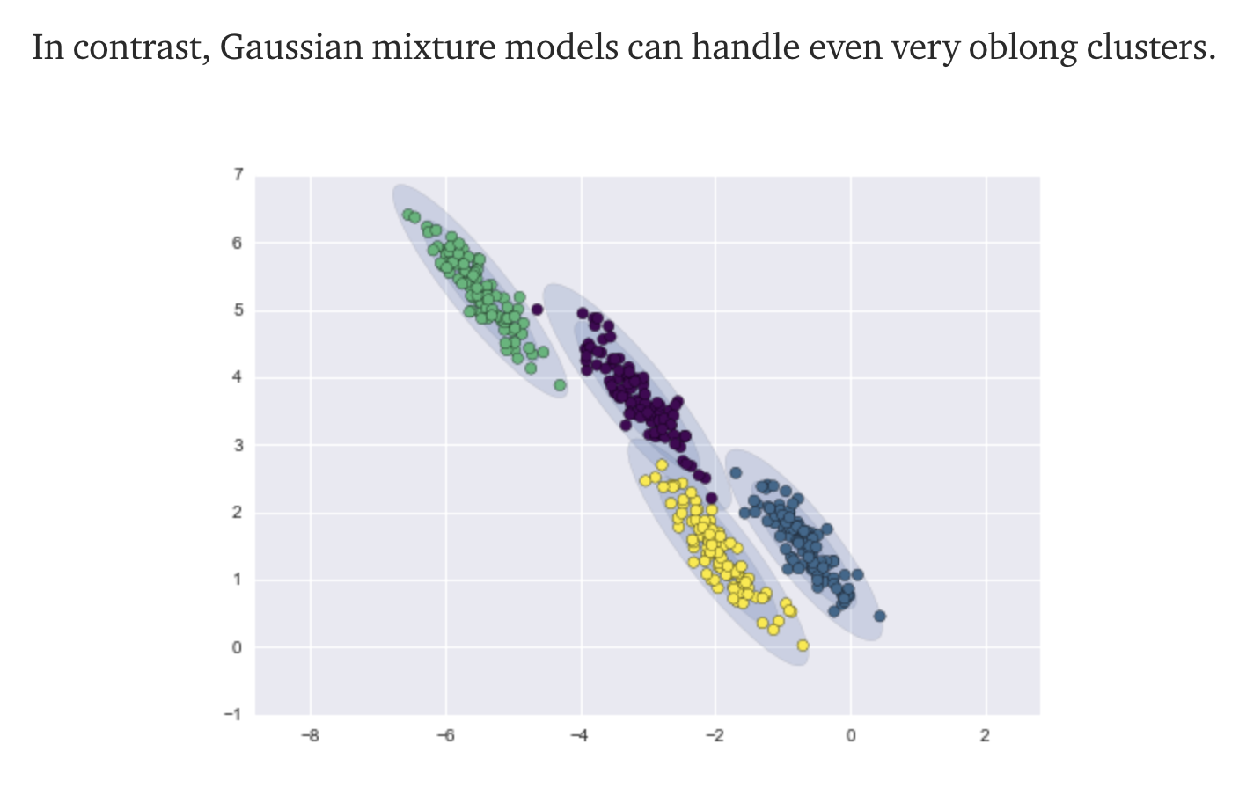
Clustering: Gaussian Mixture Models
Is used to cluster similarly to k-means, but can identify more unevenly shaped cluster.
Performs “soft” clustering by assigning a probability/score to each data point which represents the strength it’s assignment to the cluster.

Slide 4
Clustering: Hierarchal
A method of cluster analysis which seeks to build a hierarchy of clusters
Agglomerative: This is a "bottom-up" approach: each observation starts in its own cluster, and pairs of clusters are merged as one moves up the hierarchy.
Divisive: This is a "top-down" approach: all observations start in one cluster, and splits are performed recursively as one moves down the hierarchy.

Slide 5
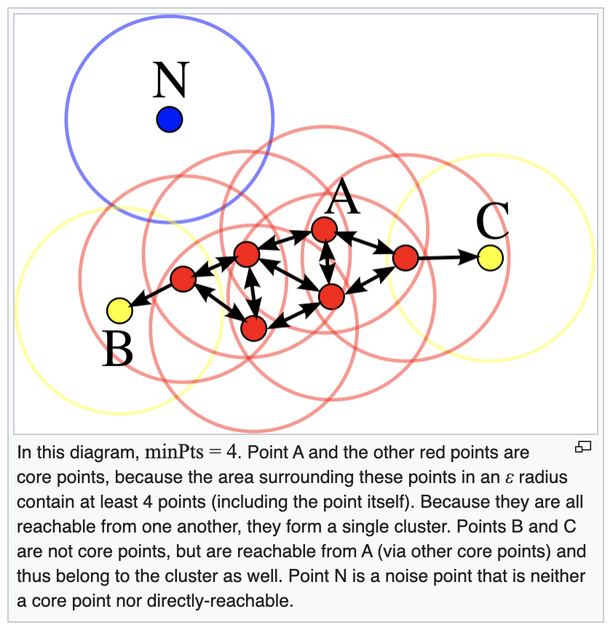
Clustering: DBSCAN
Density-based spatial clustering of applications with noise
Given a set of points in some space, it groups together points that are closely packed together (points with many nearby neighbors)

Slide 6
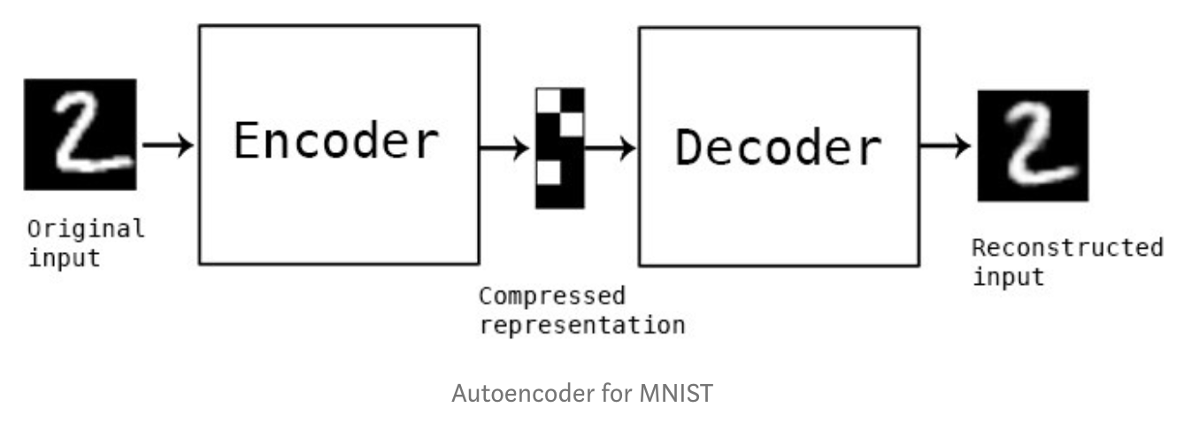
NN: Autoencoder
The aim of an autoencoder is to learn a representation (encoding) for a set of data, typically for dimensionality reduction, by training the network to ignore signal “noise”
Autoencoders learn how to efficiently compress and encode data then learns how to reconstruct the data back from the reduced encoded representation to a representation that is as close to the original input as possible.

Slide 7
NN: Deep Belief Networks (DBN)
Is a generative graphical model, or alternatively a class of deep neural network, composed of multiple layers of latent variables ("hidden units"), with connections between the layers but not between units within each layer.
When trained on a set of examples without supervision, a DBN can learn to probabilistically reconstruct its inputs. The layers then act as feature detectors. After this learning step, a DBN can be further trained with supervision to perform classification.
Unlike other models, each layer in deep belief networks learns the entire input.

Slide 8
NN: Self-organizing maps
Trained using unsupervised learning to produce a low-dimensional (typically two-dimensional), discretized representation of the input space of the training samples, called a map
SOMs useful for visualization by creating low-dimensional views of high-dimensional data, akin to multidimensional scaling

Slide 9
Principal Component Analysis
PCA transforms the feature from original space to a new feature space to increase the separation between data.
Principal component analysis is a technique for feature extraction — so it combines input variables in a specific way, then you can drop the “least important” variables while still retaining the most valuable parts of all of the variables.
Notes:
Used for high dimensional signals (WiFi)

